Slide 1

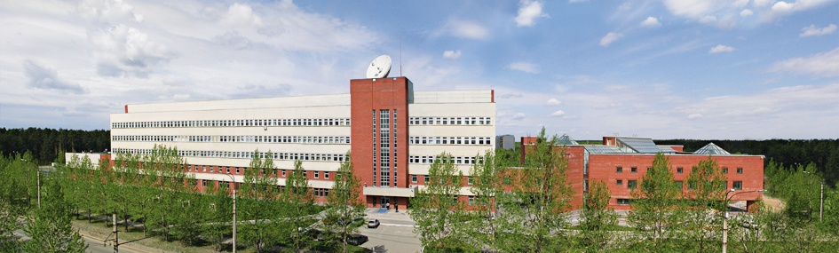
Amundsen str., 106, Ekaterinburg, Russia, 620016,
Phone: +7 (343) 267-87-96, Fax: +7 (343) 267-87-94
www.iep.uran.ru

Slide 2
MAGNETIC PULSED WELDING OF CORROSION-RESISTANT CHROMIUM STEEL TUBES WITH END PLUGS
S.N. Paranin, V.I. Krutikov, V.V. Ivanov, D.S. Koleukh, A.V. Spirin
Presentation includes:
1. Information about Institute of Electrophysics.
2. Magnetic pulsed processing.
3. Magnetic pulsed welding of corrosion-resistant chromium steel tubes
with end plugs.
www.iep.uran.ru

Slide 3
INSTITUTE OF ELECTROPHYSICS,
Ural Branch,
Russian Academy of Sciences
Location: Russia, Ekaterinburg (Middle Ural Mountains)
Date of creation 1986
Staff 250
Researchers and engineers 200
Laboratories 16
MAIN FIELDS OF RESEARCH ACTIVITIES
High Energy Density Physics and Engineering
Production and Application of Charged Particle Beams
Pulsed Power Engineering
Coherent Radiation Sources and Nonlinear Optics
Theoretical Physics

Slide 4
Magnetic Pulsed Processing
Manufacturing operations:
Forming of metal parts (sheets and tubes geometry)
Dimensional processing: cutting, punching
Joining of metal to metal and non-metal
Welding of metals
Powder compaction
Radial compression Radial expansion Flat geometry

Slide 5
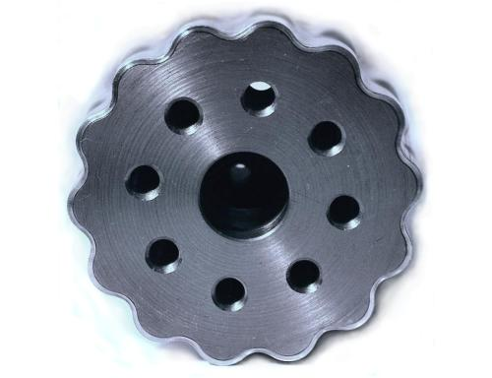
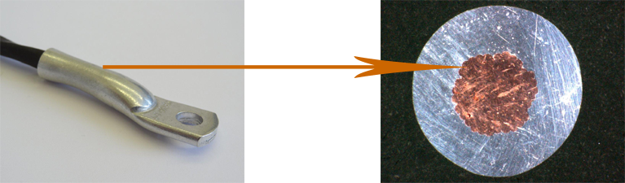
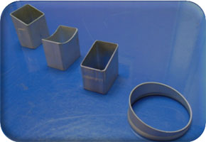
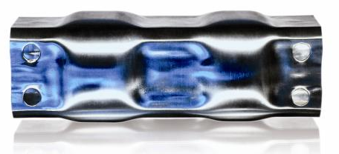
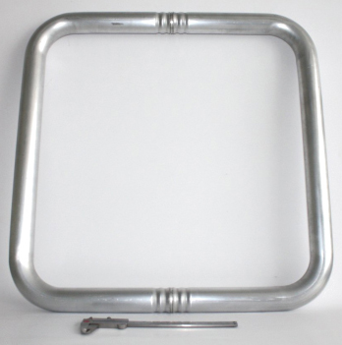
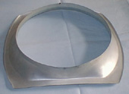
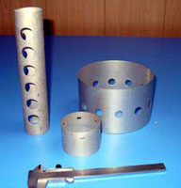
Magnetic Pulsed Processing
Forming, joining, cutting, punching

Slide 6
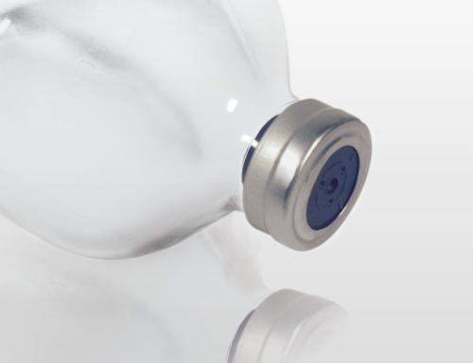
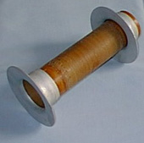
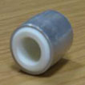
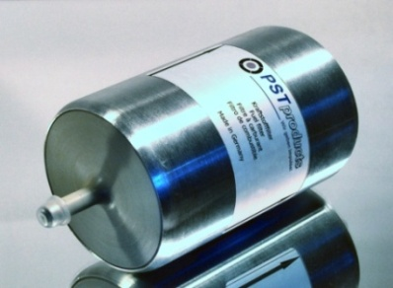
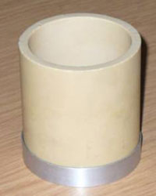
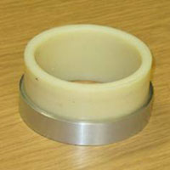
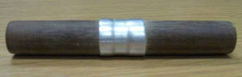
Magnetic Pulsed Processing
Joining

Slide 7
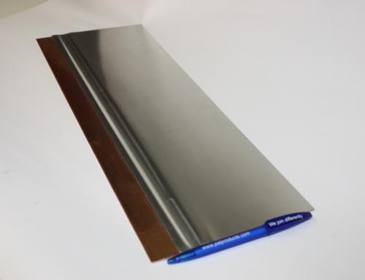
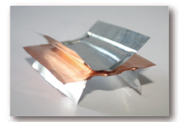
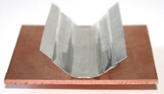
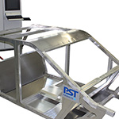
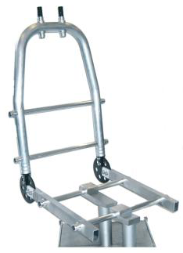
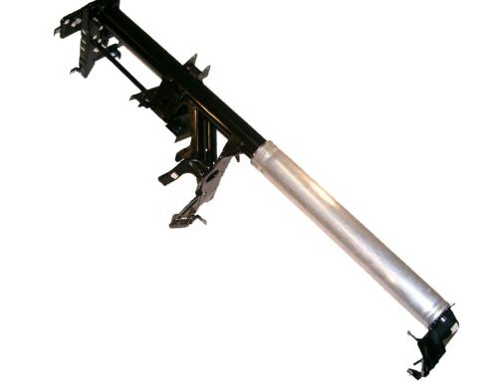
Magnetic Pulsed Processing
Welding

Slide 8
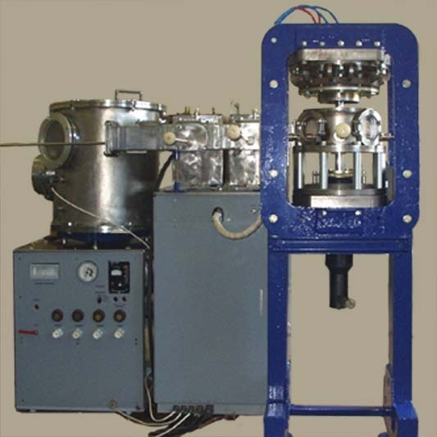
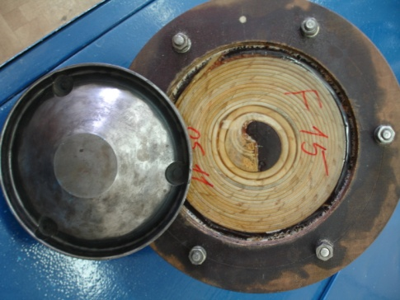
Magnetic Pulsed Processing
Uniaxial compaction
Vacuum,
30 kJ, 5 kV

Slide 9
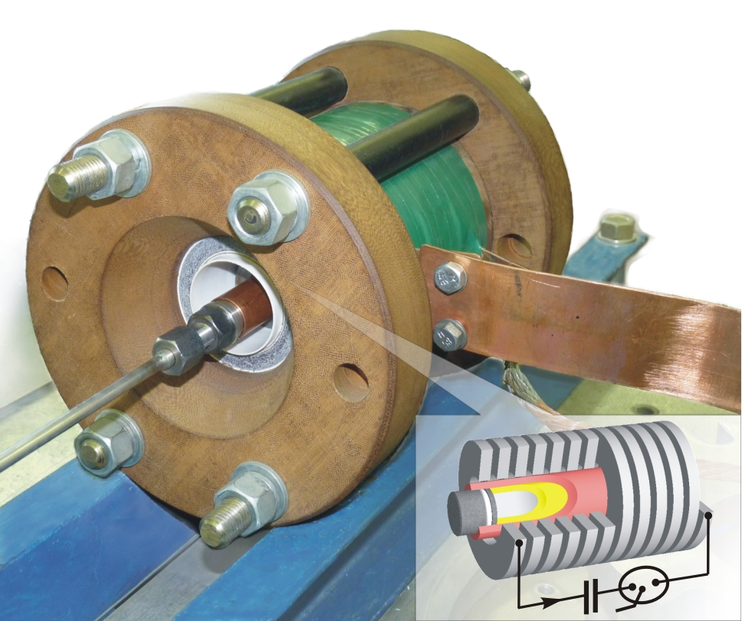
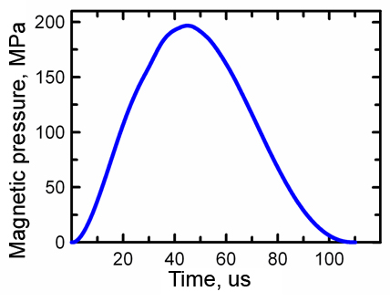
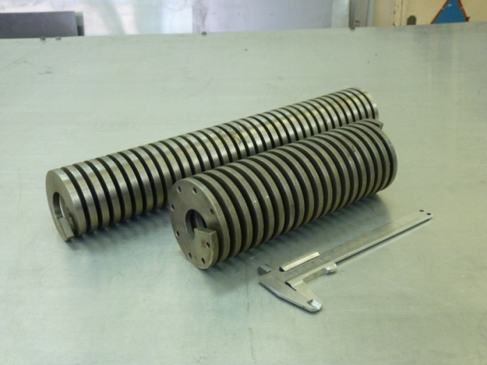
Magnetic Pulsed Processing
Radial compaction
Vacuum
135 kJ, 25 kV

Slide 10
World Companies used magnetic pulsed equipment
Magnetic Pulsed Processing
AUTO | AEROSPACE | WIDE-SECTION
General Motors | Boeing | IBM
Ford | Lockheed | Hewlett Packard
Chrysler | De Havilland | Kodak
Toyota | Northrop | Xerox
Audi | General Dynamics | Johnson and Johnson
Allied Signal | Martin Marietta | Gillette
Dana Corporation | Curtiss Wright | General Electric
Purolator Products | McDonnell Douglas | Johnson Controls
1958 – First industrial FORMING equipment (General Dynamic Corporation)
1964 – COMPACTION (D.J.Sandstrom, Consolidating metal powders magnetically, Metal Progr.,
1964, Vol. 86, No 3, pp. 215-221.)
1964 – WELDING (US Patent № 3126937, Forming method and apparatus therefor. D.F. Brower et.
al., 1964)

Slide 11
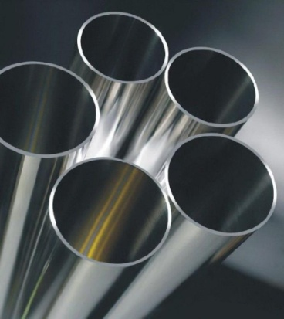
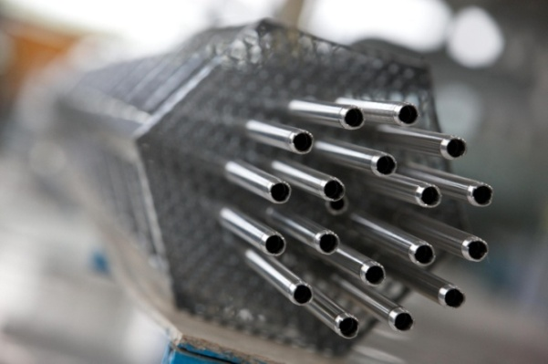
MAGNETIC PULSED WELDING OF CORROSION-RESISTANT CHROMIUM STEEL TUBES WITH END PLUGS
STS410
(AISI410)
C, % | Si, % | Mn, % | P, % | S, % | Cr, % | Fe, %
0.15 | 1.00 | 1.00 | 0.040 | 0.030 | 12.50 | Bal.
Ferritic-martensitic steel Gr91
Oxide-dispersion strengthened (ODS) steel
9 Cr ODS
X10 Cr V Nb Mo 9
The aim of research – investigation of MPW conditions to provide the relevant weld connection of the tube to the end plug made out of chromium steel.

Slide 12
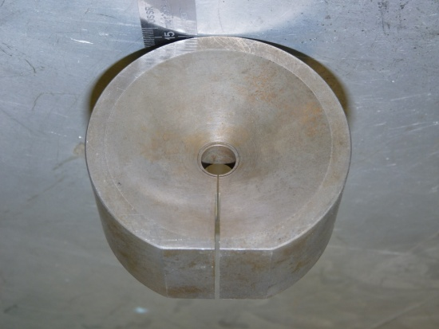
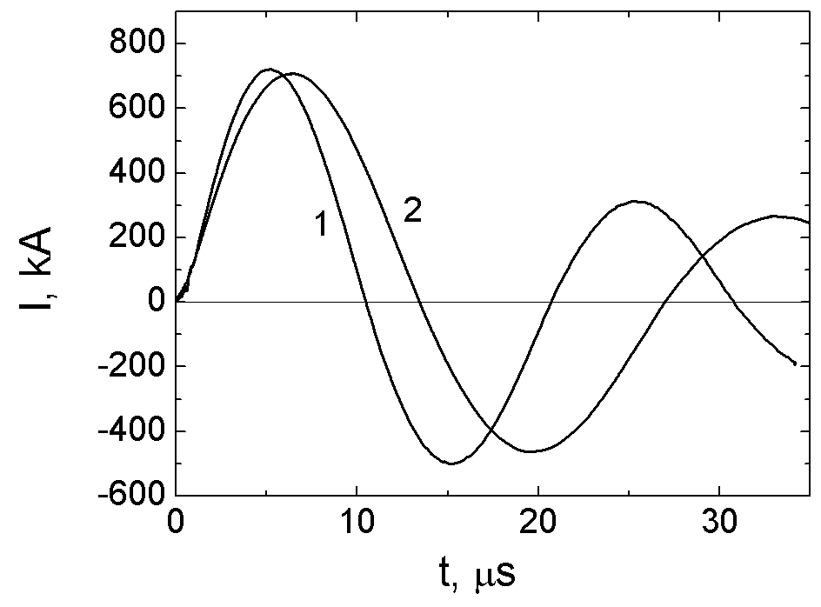
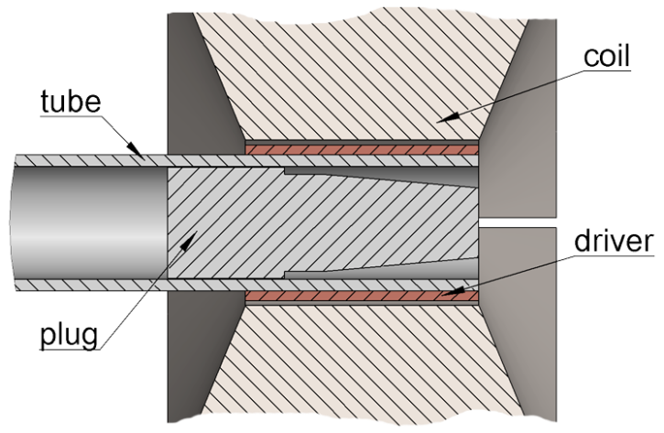
MAGNETIC PULSED WELDING OF CORROSION-RESISTANT CHROMIUM STEEL TUBES WITH END PLUGS
C
Typical current waveforms at two battery capacities 1 – 210 μF, 2 – 420 μF
Magnetic Pulsed Unit
Battery capacity, μF 425 210
Charge voltage, kV 8 – 9,5 11 – 13
Current half-period T/2, μs 14 10
Current amplitude, kA 670 – 740
Magnetic field amplitude, T 37 – 42
Fracture of YSZ compact

Slide 13
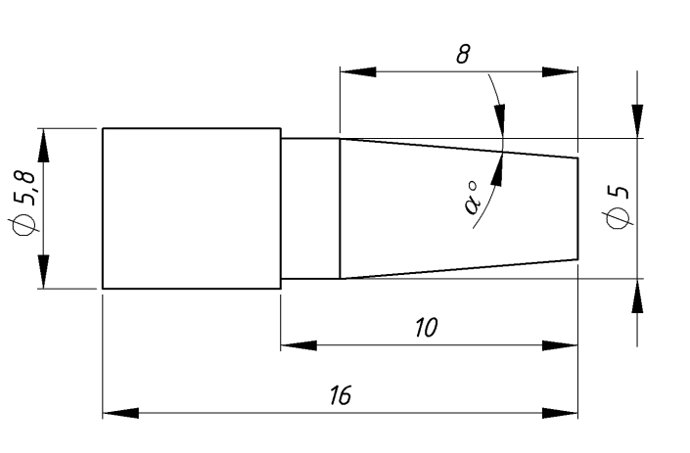
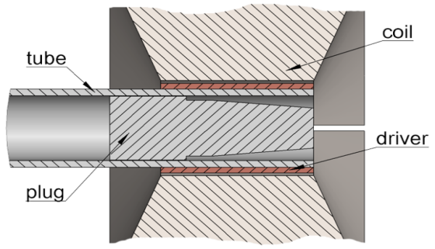
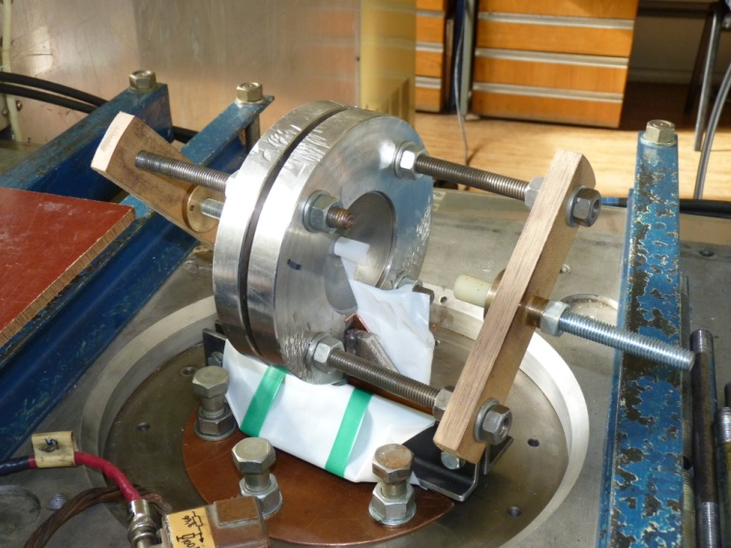
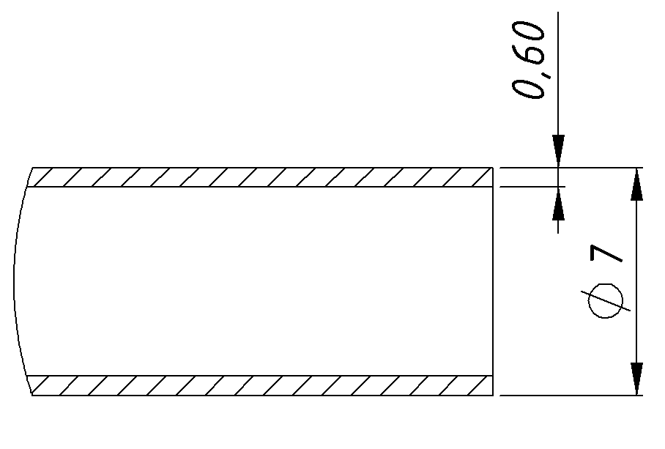
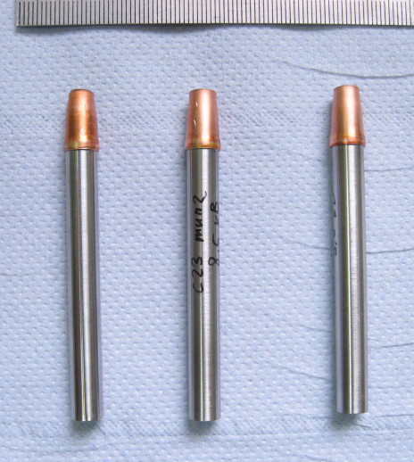
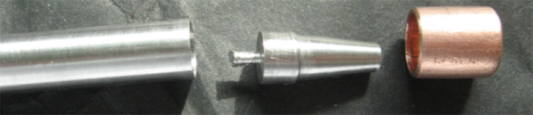
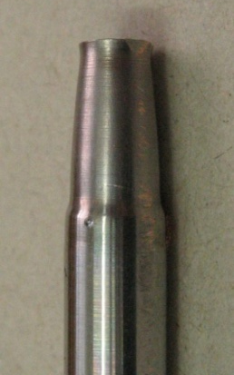
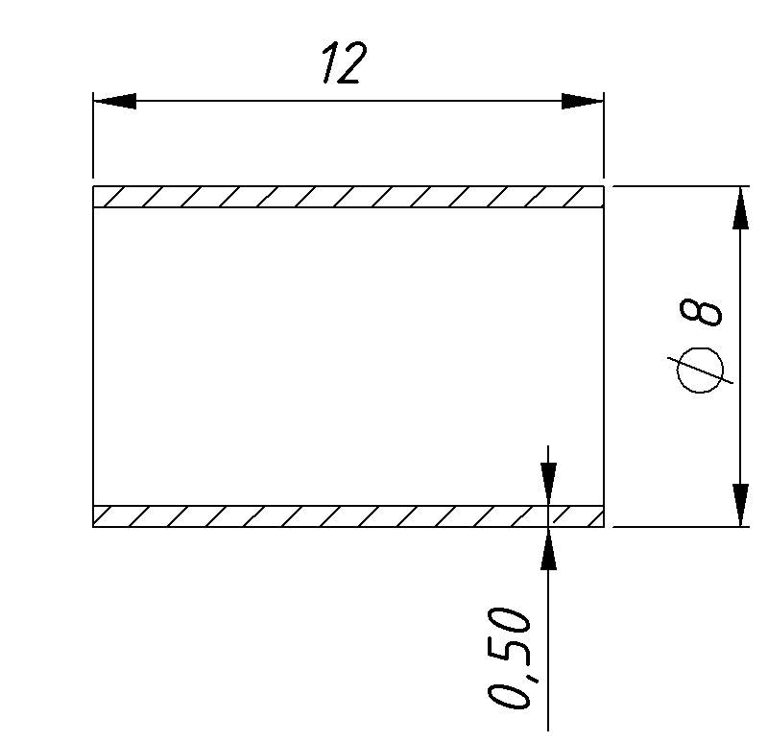
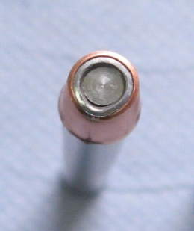
MAGNETIC PULSED WELDING OF CORROSION-RESISTANT CHROMIUM STEEL TUBES WITH END PLUGS
End plug
Tube
Copper
driver
W.F. Brown, J. Bandas, N.T. Olson, Magnetic welding of
breeder reactor fuel pin end closures, Welding J.,
1978, no. 6, pp. 22–26

Slide 14
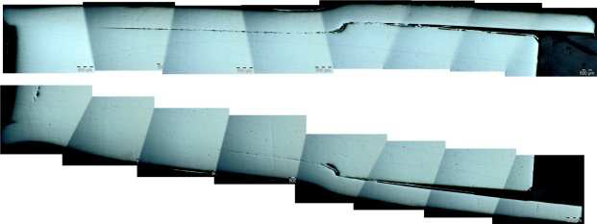
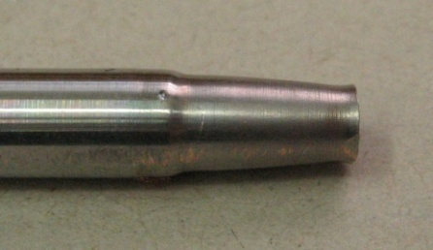
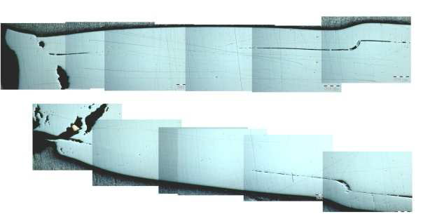
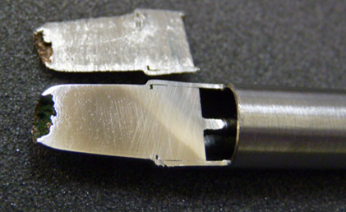
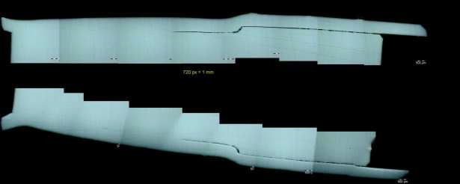
MAGNETIC PULSED WELDING OF CORROSION-RESISTANT CHROMIUM STEEL TUBES WITH END PLUGS
Uo C I
kV µF kA
8.5 425 700
9.5 425 810
13 210 740

Slide 15
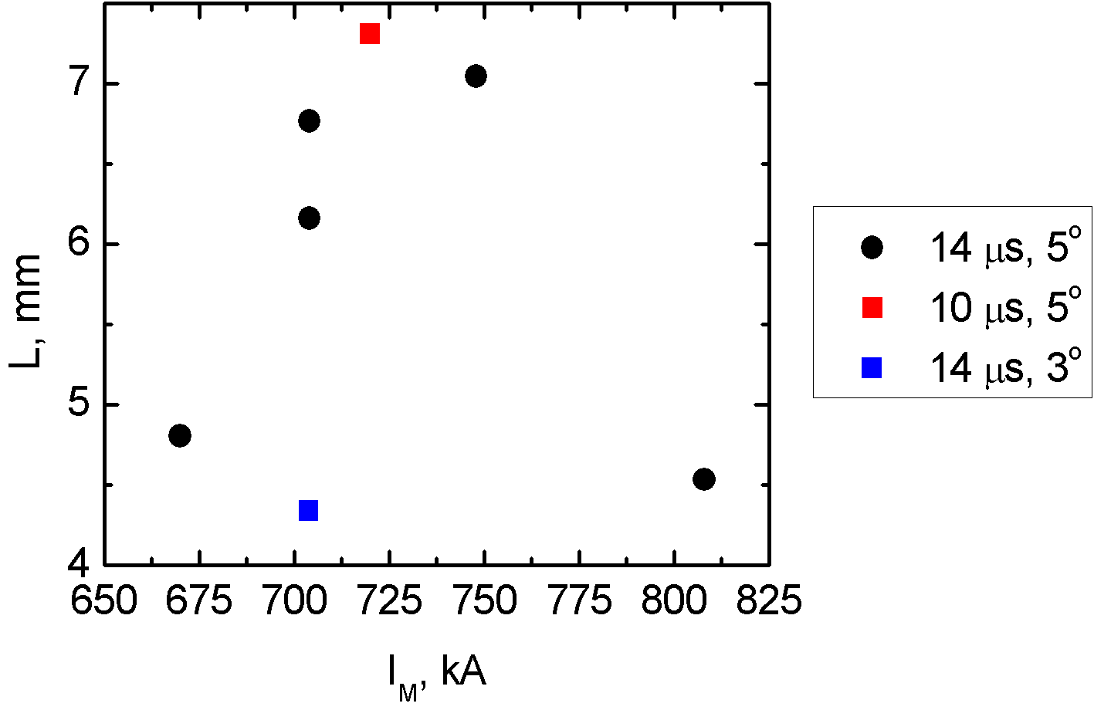
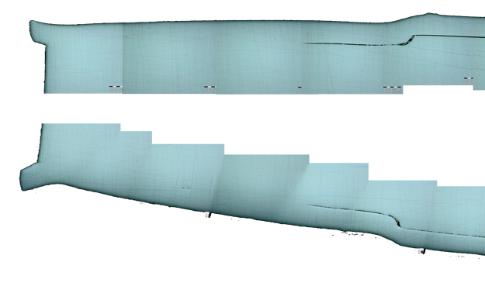
MAGNETIC PULSED WELDING OF CORROSION-RESISTANT CHROMIUM STEEL TUBES WITH END PLUGS
He leak rate
< 2·10⁻⁹ mbar·l/s
< 1·10⁻⁹ mbar·l/s
L
Sample’s longitudinal section.
Weld conditions:
T/2 = 10 μs, α = 5°, I_{M} = 720 kA
Maximum weld region length was L = 7.2 mm

Slide 16
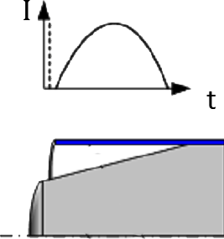
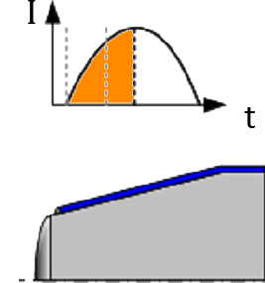
MAGNETIC PULSED WELDING OF CORROSION-RESISTANT CHROMIUM STEEL TUBES WITH END PLUGS
α, [°] | I_{m}, [kA] | B_{m}, [T] | T/2, [μs] | t, [μs] | V, [m/s] | V_{K}, [km/s]
5 | 704 | 37 | 14 | 6.15 | 293 | 3.6
3 | 704 | 37 | 14 | 6.3 | 320 | 6.3
5 | 720 | 38 | 10 | 5.0 | 285 | 3.4
Δ
L
Vc=V/sinα

Slide 17
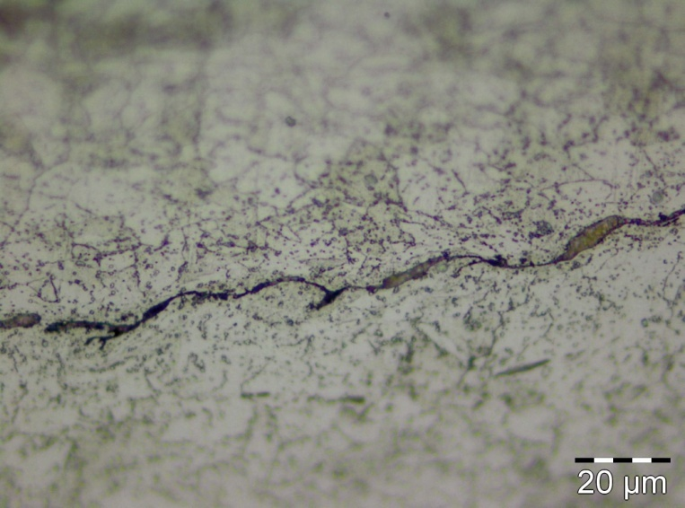


MAGNETIC PULSED WELDING OF CORROSION-RESISTANT CHROMIUM STEEL TUBES WITH END PLUGS
Etched surfaces of welded specimens
C = 425 µF T = 28 µs
I_{M} = 670 кА
I_{M} = 700 кА
I_{M} = 750 кА

Slide 18





MAGNETIC PULSED WELDING OF CORROSION-RESISTANT CHROMIUM STEEL TUBES WITH END PLUGS
 | Angle (a°) | C (μF) | V (kV) | E (kJ) | T/2 (μs) | I_{m} (kA)
① | 5.1 | 220 | 13 | 18.6 | 11.0 | 724
② | 5.3 | 425 | 9 | 17.2 | 13.4 | 749
③ | 5.1 | 220 | 14 | 21.6 | 9.92 | 790
④ | 5.4 | 220 | 13 | 18.6 | 9.84 | 713
  Tube: 9Cr ODS steel
    O.D.: 6.6 mm, t: 0.45 mm
  End-plug: Gr.91 F/M steel
①
③
②
④

Slide 19
www.iep.uran.ru
Amundsen str., 106, Ekaterinburg, Russia, 620016,
Phone: +7 (343) 267-87-96, Fax: +7 (343) 267-87-94

